Slide 1
Data Science Capstone Project - Unleashing Insights from Football Data Using Multiple Tools (3 Sprints)
By T. Nandikha

Slide 2
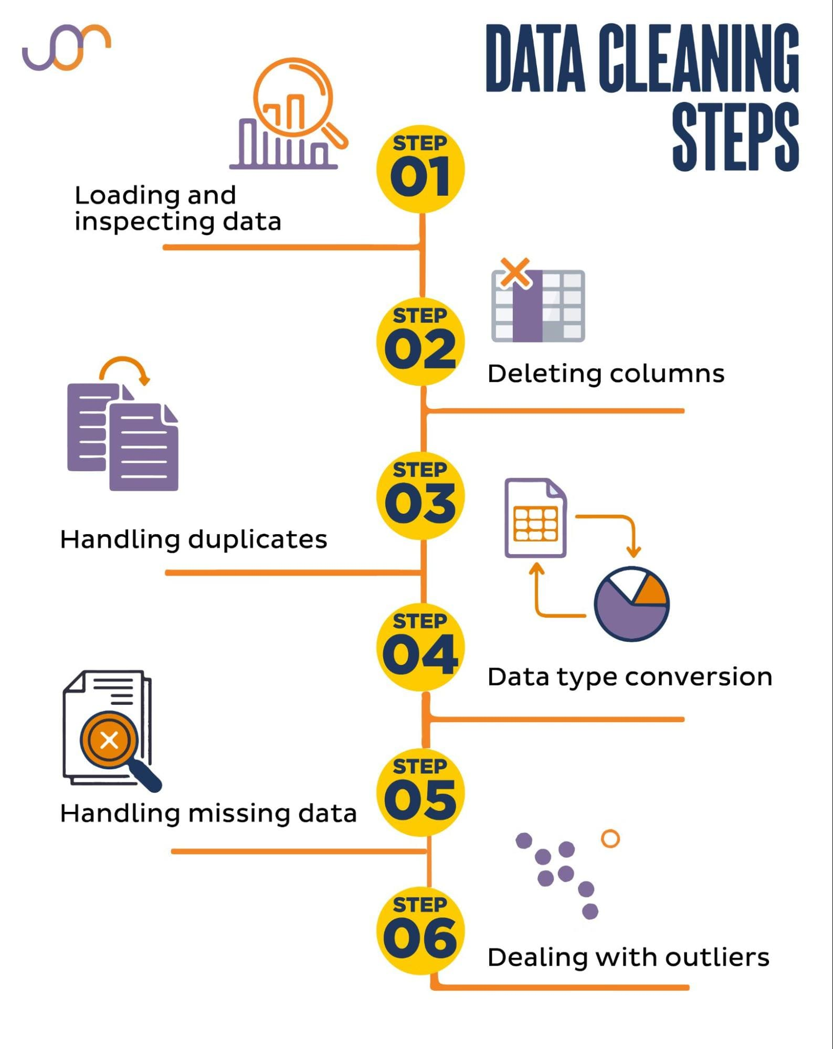
Overview of the data treatment process using a contextual diagram

Slide 3
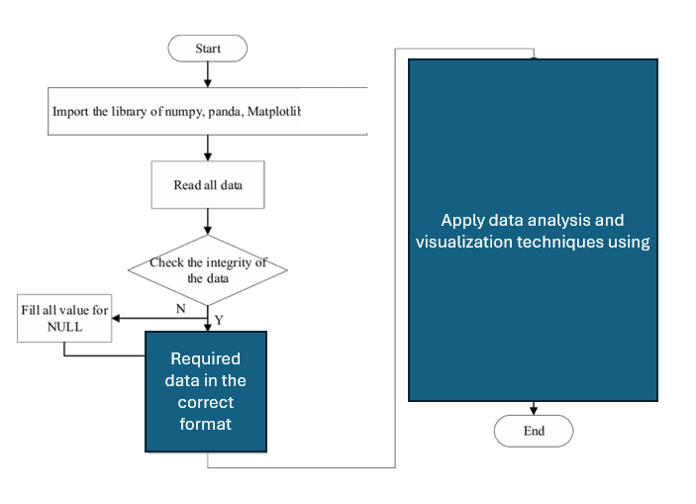
Application of Data Analysis Techniques Illustrated with a Contextual Diagram
Python:

Slide 4
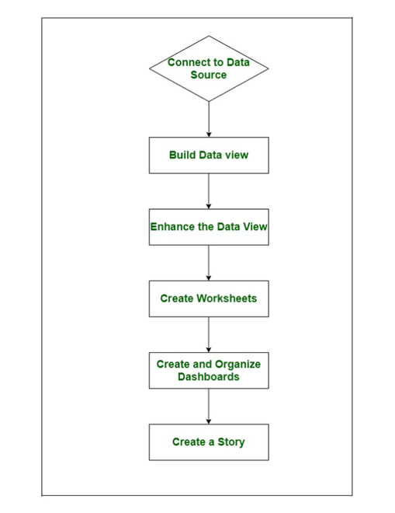
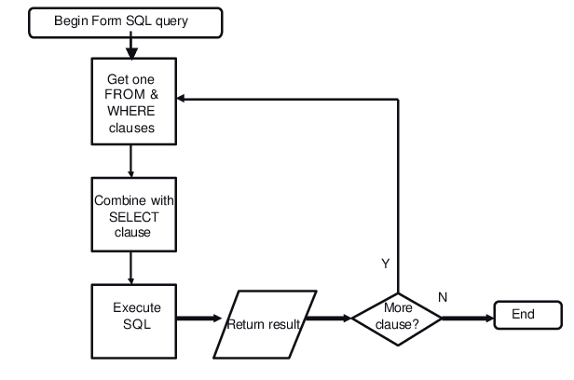
Application of Data Analysis Techniques Illustrated with a Contextual Diagram
SQL:
TABLEAU:

Slide 5
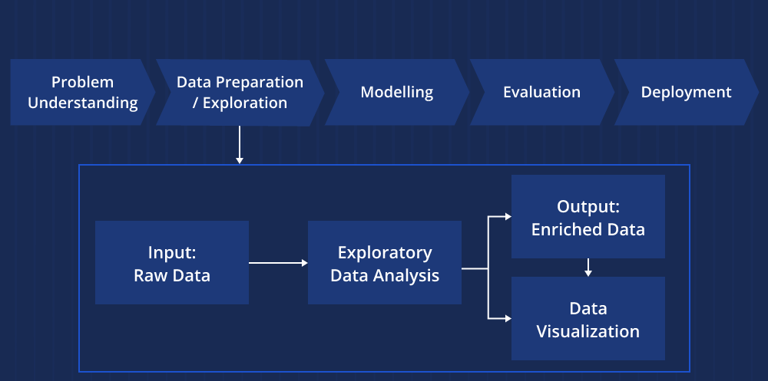
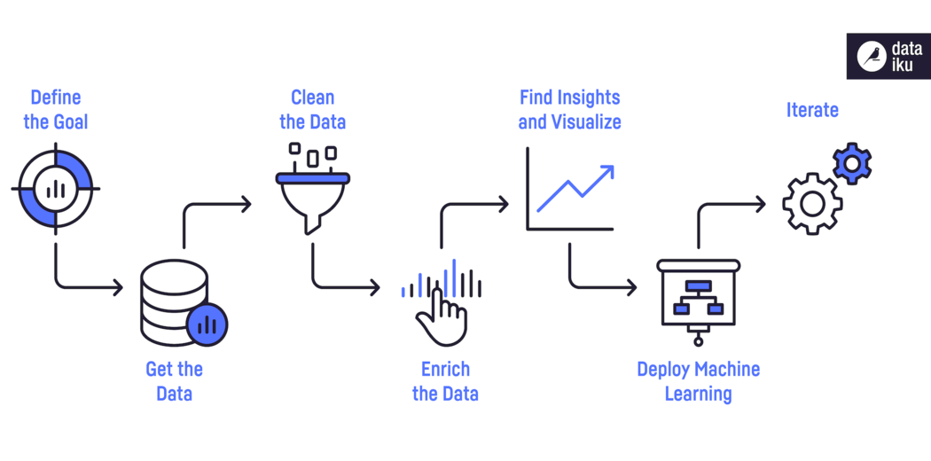
Application of Data Analysis Techniques Illustrated with a Contextual Diagram
EDA:
EXCEL:

Slide 6
Sprint 1: Generating Business Objectives

Slide 7
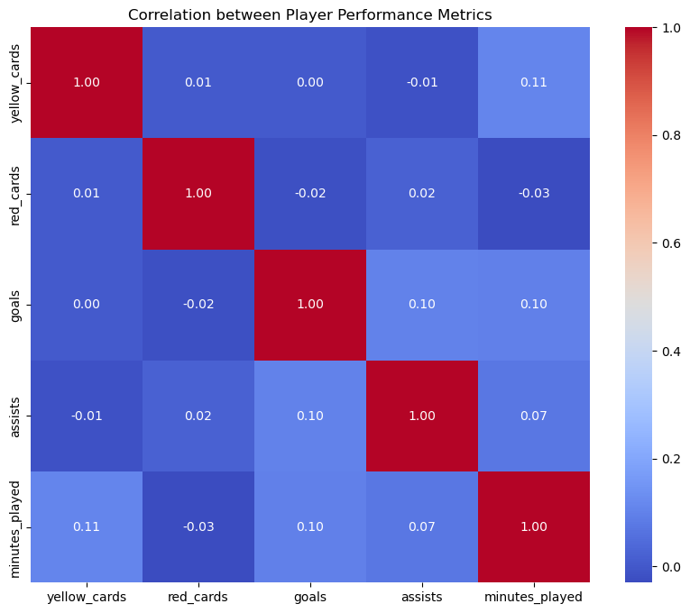
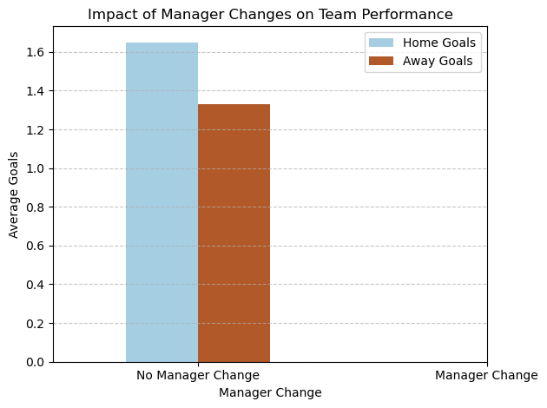
PYTHON
1. Performance Analysis:
Objective 1: Evaluate and analyze player performance based on various metrics such as goals, assists, yellow cards, red cards, and minutes played.
Question 2: How do yellow and red cards correlate with player performance metrics?
Inference: Yellow and red cards show a strong correlation within their own type but have a very low correlation with each other. Yellow cards are associated with higher goal-scoring, fewer assists, and more playing time, while red cards are linked to potentially lower goals, more assists, and less playing time.
Objective 2: Assess team performance in terms of home and away goals, club positions, and manager influence.
Question 4: Is there a significant impact of club manager changes on team performance?
Inference: Higher Home Goals with Manager Change, Potential Increase in Home Advantage, Rejuvenated Team Performance
Summary: A higher number of home goals compared to away goals after a manager change suggests that the change in management has positively influenced the team's performance, particularly in terms of scoring goals in home matches. However, it's essential to conduct a comprehensive analysis considering other factors to validate this observation fully.

Slide 8
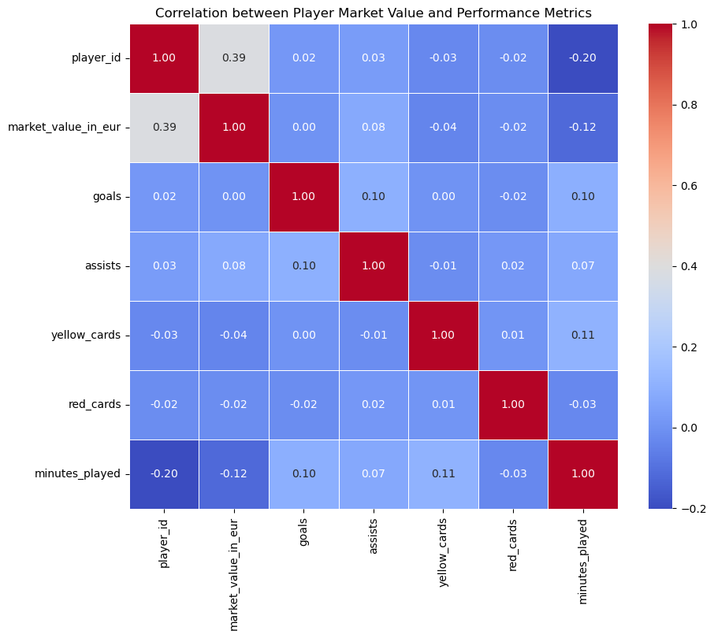
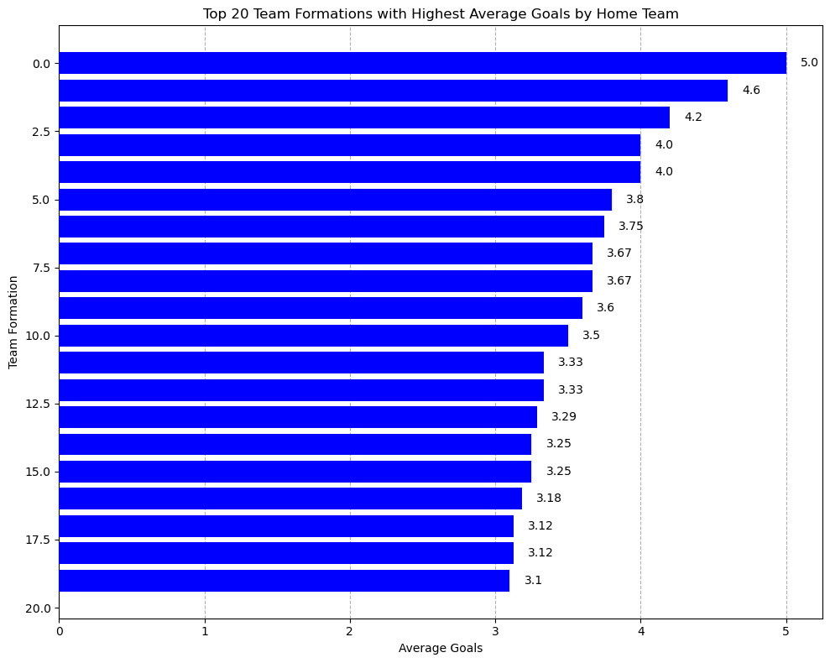
2. Player Profile and Market Value:
Objective 2: Profile players based on their demographics and playing positions.
Question 8: What are the common career trajectories for players in different positions?
Inference:
- There is a weak positive correlation between a player's market value and the number of goals and assists they achieve. This suggests that players who score more goals and provide more assists tend to have slightly higher market values, although the correlation is not very strong.
- On the other hand, there is a negative correlation between a player's market value and the minutes they play. Players who play more minutes tend to have lower market values. This could be because they are more prone to injuries or because they are not as impactful as players who make a greater impact in fewer minutes.
- Age, height, weight, yellow cards, and red cards show little to no correlation with a player's market value.
3. Team Comparison:
Objective 2: Identify the factors contributing to a team's success.
Question 12: How do different team formations affect match outcomes?
Inference: The bar graph shows that different team formations lead to varying average goals by the home team, ranging from 3.0 to 5.0. It suggests that team formations significantly influence match outcomes, with more attacking formations scoring higher. This highlights the importance of offensive strategies in a team's success and the need to optimize formations based on strengths and opposition.

Slide 9
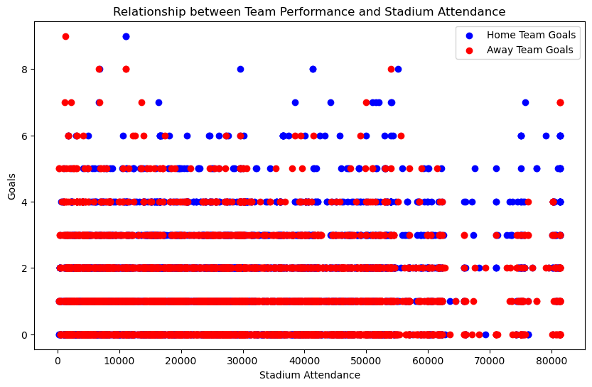
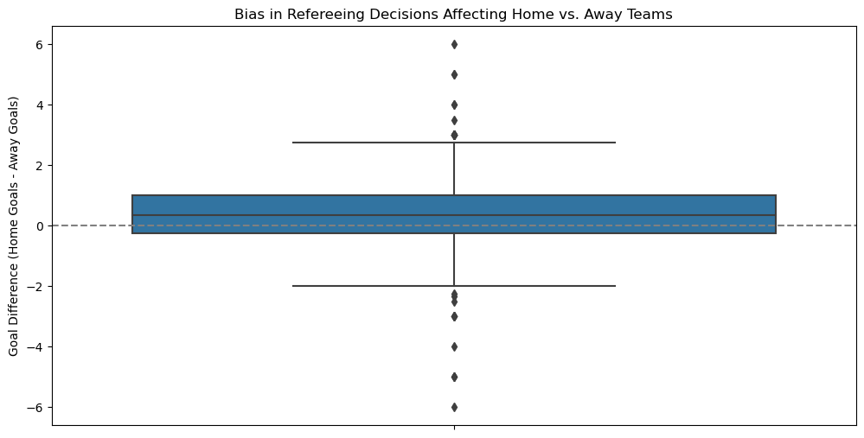
4. Attendance and Stadium Analysis:
Objective 1: Examine the factors affecting match attendance.
Question 14: What is the relationship between team performance and stadium attendance?
Inference: 1. Positive Correlation Between Goals and Attendance, 2. Impact of Team Performance on Attendance, 3. Fan Engagement and Retention, 4. Entertainment Value, 5. Strategic Focus for Clubs
Summary: The graph shows that there is a strong association between team performance, particularly in terms of goals scored by the home team, and higher stadium attendance. This underscores the importance of on-field success in attracting and maintaining a robust fan base.
5. Referee Analysis:
Objective 1: Evaluate the impact of referees on match outcomes.
Question 18: Is there any noticeable bias in refereeing decisions affecting home vs. away teams?
Inference: 1. Bias Towards Home Teams, 2. Greater Magnitude of Home Bias, 3. Variation in Referee Performance, 4. Potential Influence on Match
Summary: The graph suggests a noticeable bias in refereeing decisions that favor home teams over away teams, with a greater magnitude of positive bias. This bias can significantly impact match outcomes, highlighting the importance of addressing potential referee biases to ensure fair competition.

Slide 10
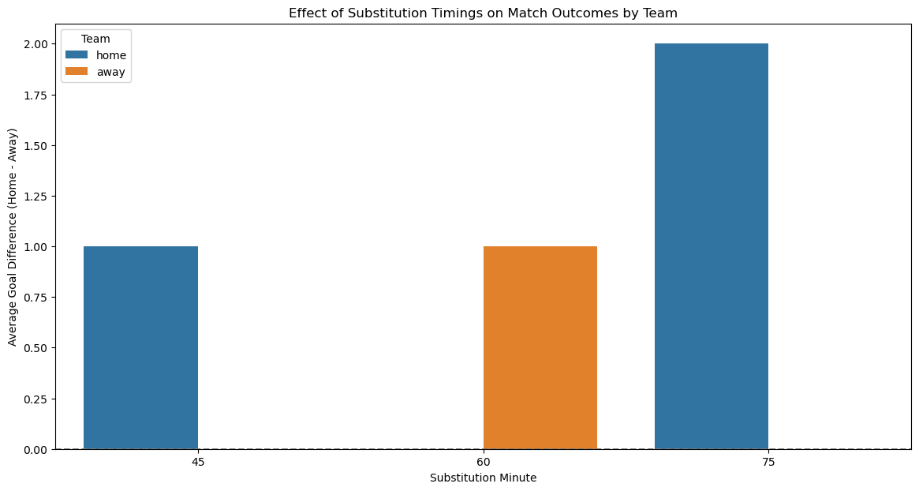
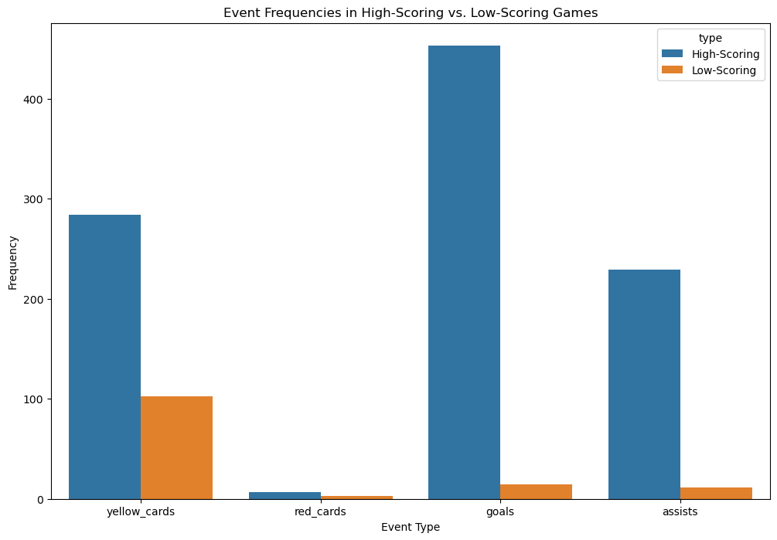
6. Substitution Patterns:
Objective 1: Analyze the strategic use of substitutions in matches.
Question 22: How do substitution timings affect match outcomes?
Inference: This graph shows how the timing of substitutions affects the score difference in a match. On average, teams that make substitutions around the 60th minute see the biggest difference in goals scored by the home team compared to the away team. Overall, the home team tends to score more throughout the game.
7. Event Analysis:
Objective 1: Study the distribution and frequency of various match events.
Question 26: How do event frequencies differ between high-scoring and low-scoring games?
Inference: Event frequencies are generally higher in highscoring games. This makes sense because there's more overall activity happening in a game more goals. The graph shows the frequency of yellow cards, red cards, goals, and assists. For each event type, the frequency is higher in high-scoring games compared to Iow-scoring games. The difference in frequency seems to be the greatest for goals, followed by assists. This suggests that high-scoring games not only have more goals, but also tend to have more plays that lead to goals (assists). Overall, the graph suggests a positive correlation between event frequency and goal scoring. Games wth more goals tend to see more action across the board includin more cards oals and assists

Slide 11
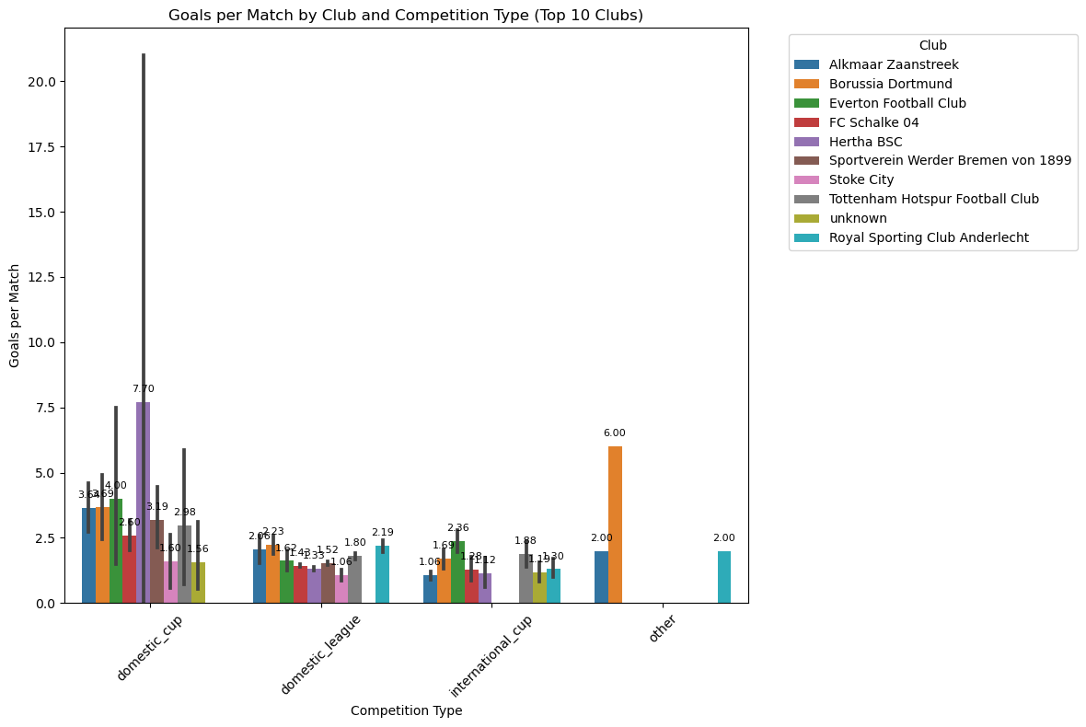
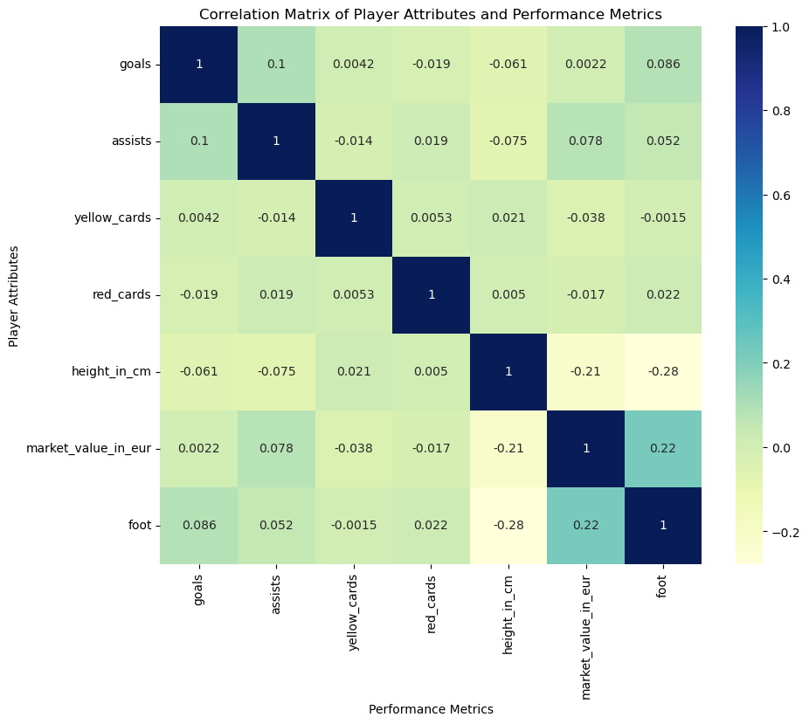
8. Competition Analysis:
Objective 1: Compare the performance of clubs across different competitions.
Question 30: What are the goals per match for the top 10 clubs in different competition types?
Inference: Analyzing goals per match for top clubs, we can see a trend of higher scoring in domestic cups compared to other competitions. Interestingly, domestic leagues show a wider range in goals scored, while FC Schalke 04 leads the pack with the highest overall average and Stoke City lags behind with the lowest. However, keep in mind this only considers the top IO clubs.
9. Player Attributes and Demographics:
Objective 1: Analyze the physical and technical attributes of players.
Question 34: How do player attributes correlate with their performance metrics?
Inference: Positive correlations are shown by values closer to 1. For example, there is a positive correlation between goals and assists (0.19). This means that players with more goals tend to also have more assists. Negative correlations are Shown by Closer to -1. For example, there is a negative correlation between height and red cards (-0.28). This means that taller players tend to get fewer red cards. Values closer to O show a weak correlation between two metrics, For instance, there is a weak correlation between market value and foot (0.22). This suggests that a player's preferred foot doesn't necessarily have a big impact on their market value.

Slide 12
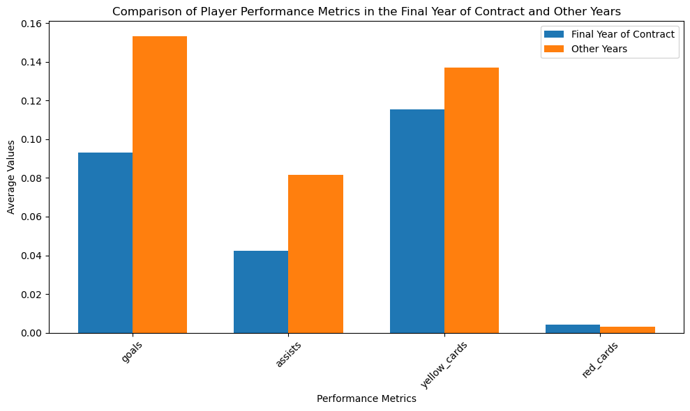
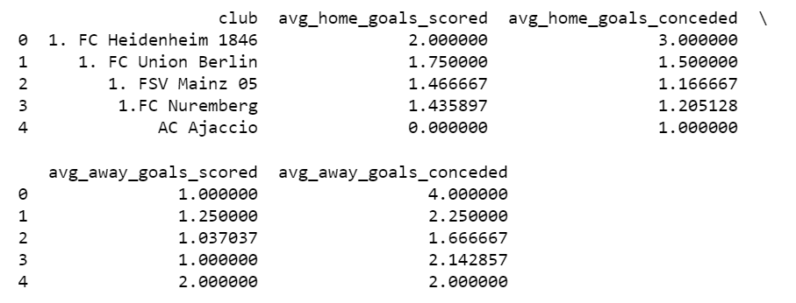
EDA
10. Contract Management:
Objective 1: Evaluate the impact of contract durations on player performance.
Question 37: How do players' performance metrics vary in the final year of their contracts compared to other years?
Inference: Players tend to score more goals and have more assists in their final year of contract according to the higher averages for these metrics in the final year. Conversely, players tend to get fewer yellow and red cards in their final year of contract, as shown by the lower averages for these metrics in the final year. It is important to note that this graph only shows average values and may not reflect the performance of all players in their final year of contract.
1. Performance Analysis:
Objective 2: Assess team performance in terms of home and away goals, club positions, and manager influence.
Question 3: How does home advantage affect team performance in terms of goals scored and conceded?
INFERENCE FROM OUTPUT: The output data shows that most teams perform better at home, scoring more goals and conceding fewer. For example, 1. FC Heidenheim 1846 and 1. FC Nuremberg have notable home advantages with significantly better offensive and defensive records at home. Union Berlin and Mainz 05 also show improved performance at home. AC Ajaccio is an outlier, scoring no goals at home but more away, while their defensive performance is consistent. Overall, the analysis highlights the general trend of home advantage in football, where teams typically have stronger performances on their home grounds.

Slide 13
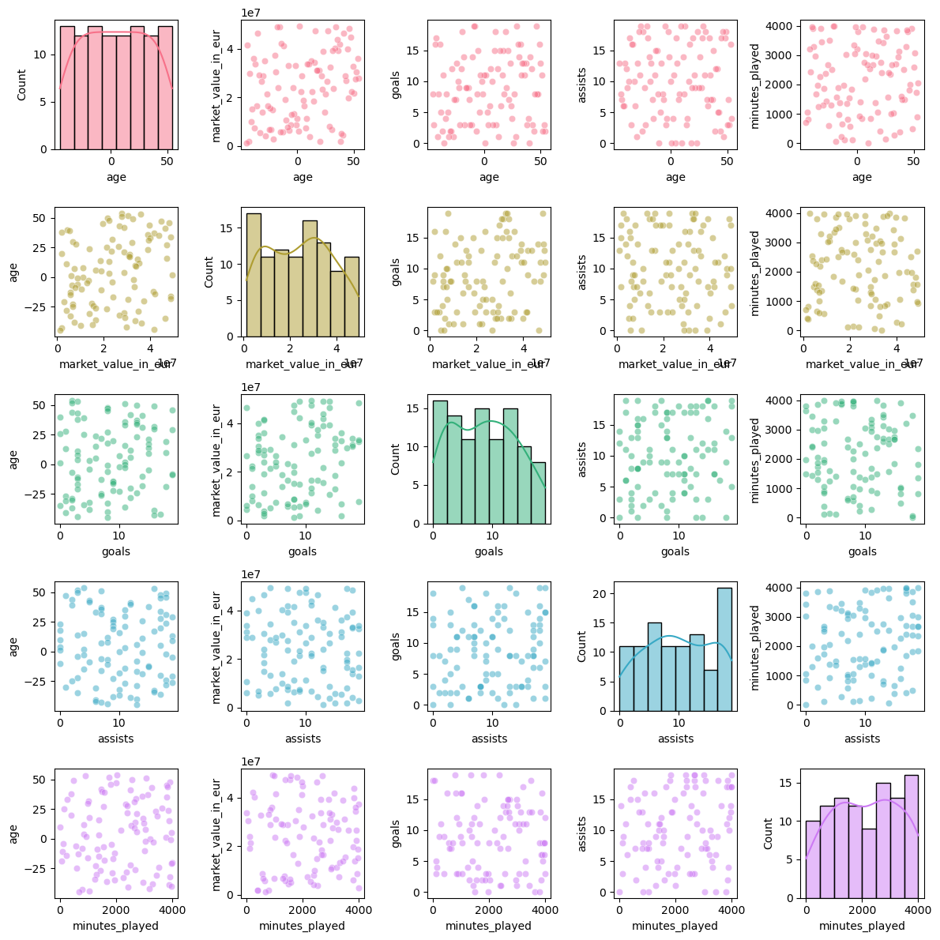
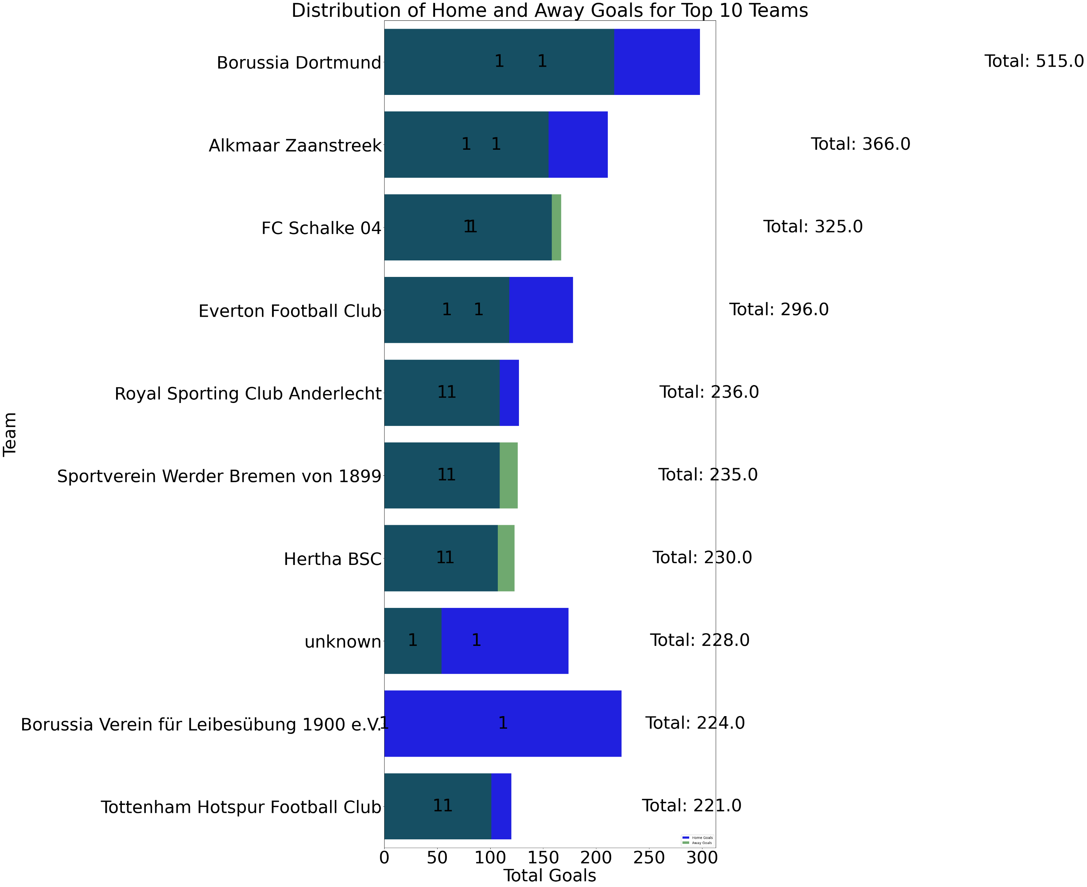
2. Player Profile and Market Value:
Objective 1: Analyze the correlation between player market value and performance metrics.
Question 6: How do players' market values change with age and performance?
Inference: Analyzing the graph, we see younger players generally have lower market value than experienced ones, but strong performance in goals, assists, and playing time boosts value for all ages. This impact is strongest for young players, suggesting exceptional performance can significantly raise their market value compared to older athletes. It's worth noting these are trends, with some young players valued highly for potential despite lower stats, and performance's influence seems to diminish around age 35.
3. Team Comparison:
Objective 1: Compare the performance of top teams across different seasons.
Question 9: How do the distribution of home and away goals vary among the top 10 teams in the dataset?
Inference: There is a trend where most teams score more goals at home than away. This is because the taller bars on the graph tend to be on the left side (home) for most teams. For example, Borussia Dortmund scores the most goals at home (around 515) and the least goals away (around 224). However, there are a few exceptions, like FC Schalke 04, who appear to score a similar number of goals at home and away. Overall, the graph suggests that home field advantage plays a role in goal scoring for these top teams.

Slide 14
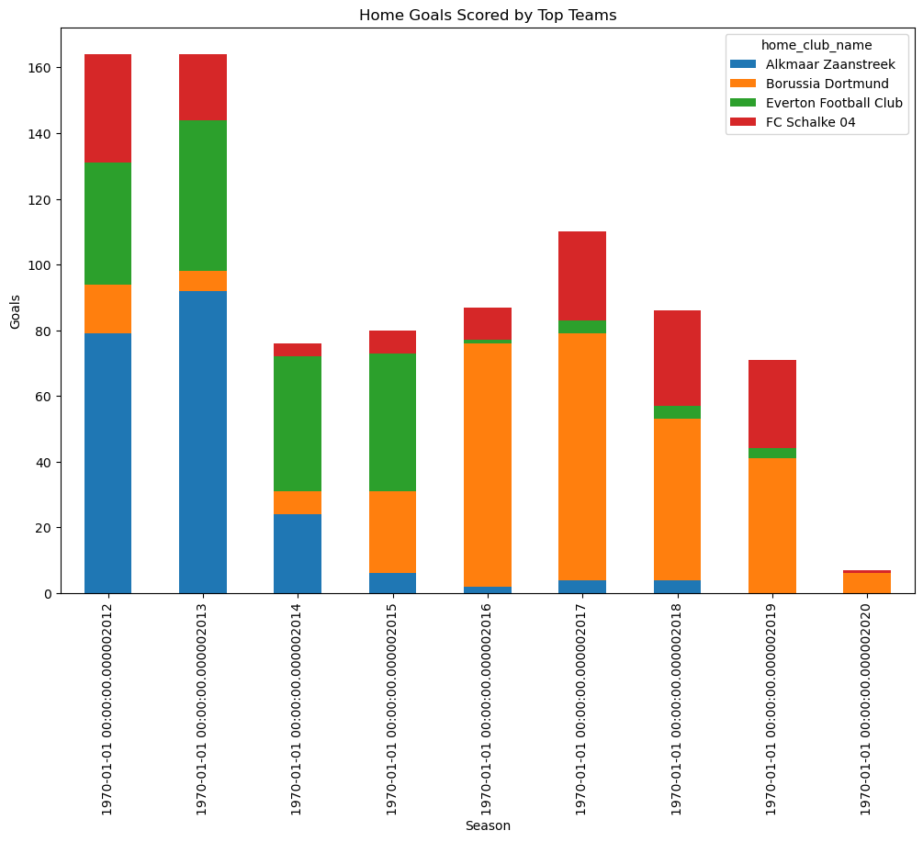
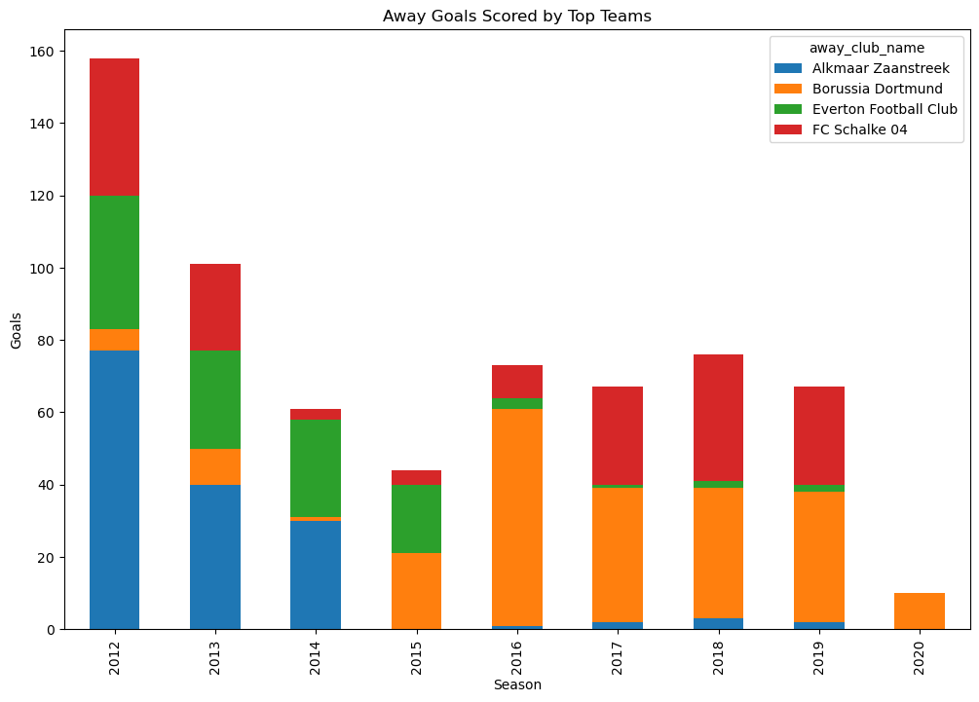
3. Team Comparison:
Objective 1: Compare the performance of top teams across different seasons.
Question 10: How do the top teams compare in terms of goals scored and defensive strength? Inference: Examining the output graph, Borussia Dortmund stands out as the top home scorer across several seasons (likely 2012-2020), consistently exceeding other teams and potentially reaching over 100 goals in some seasons. Everton and Schalke also show respectable home goal counts, typically between 20 and 100, while Alkmaar Zaanstreek appears to be the least prolific scorer, with their home goals ranging from 20 to 100 over the years. It's important to consider that without knowing the league average goals scored per season, a definitive comparison of their performance is difficult.

Slide 15
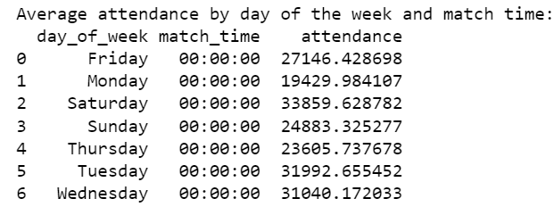
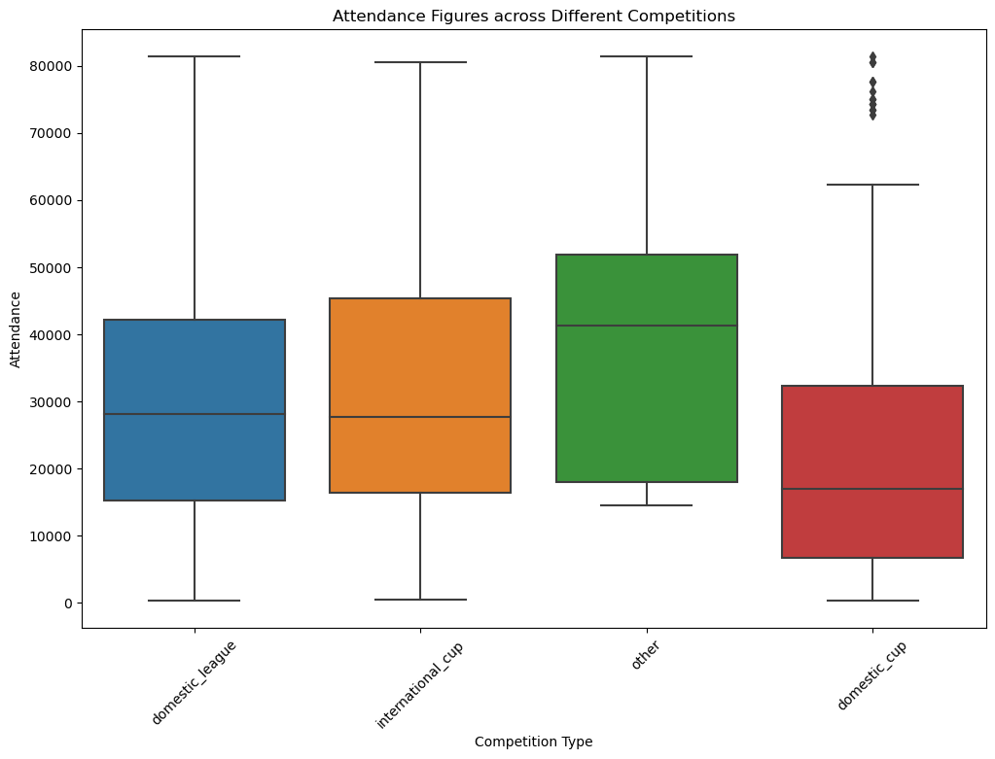
4. Attendance and Stadium Analysis:
Objective 1: Examine the factors affecting match attendance.
Question 13: How does the day of the week and time of the match influence attendance? INFERENCE: From the output, Observations about average attendance by day of the week are:
Saturday has the highest average attendance at close to 34,000.
Tuesday has the second highest average attendance at over 31,000.
Friday and Wednesday have the lowest average attendance at around 27,000 and 31,000, respectively.
Overall, attendance appears to be higher on weekdays than weekends with the exception of Saturday.
4. Attendance and Stadium Analysis:
Objective 2: Analyze stadium usage and capacity utilization.
Question 16: How do attendance figures vary across different competitions? INFERENCE: The output graph shows big differences in how many people attend each type of competition.
Olympic Games are the most popular, with most games attracting over 70,000 fans.
International Cups are next, usually bringing in more than 50,000 people.
Domestic Leagues tend to have the fewest fans, typically between 10, 000 and 50,000.
Domestic Cups seem a bit more popular than Leagues, with attendance ranging from 20,000 to 60,000.
It's important to remember this is just a general picture, and there might be some exceptions. For instance, some Domestic League games could have a lot more fans than usual, even though overall attendance is lower than other competitions.

Slide 16
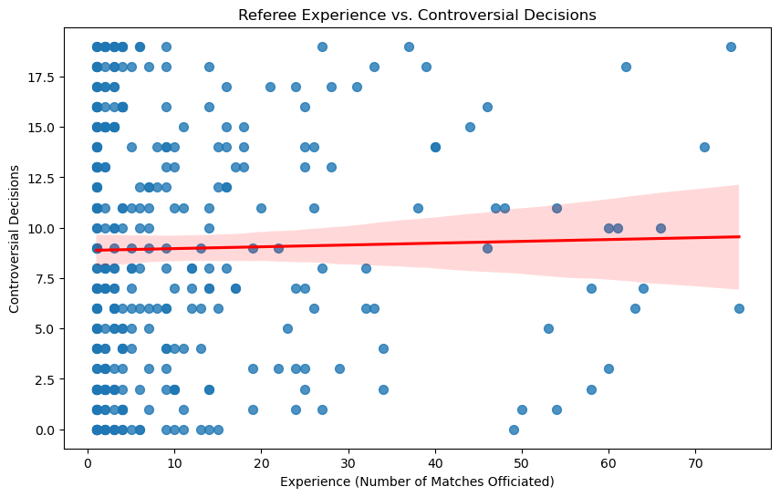
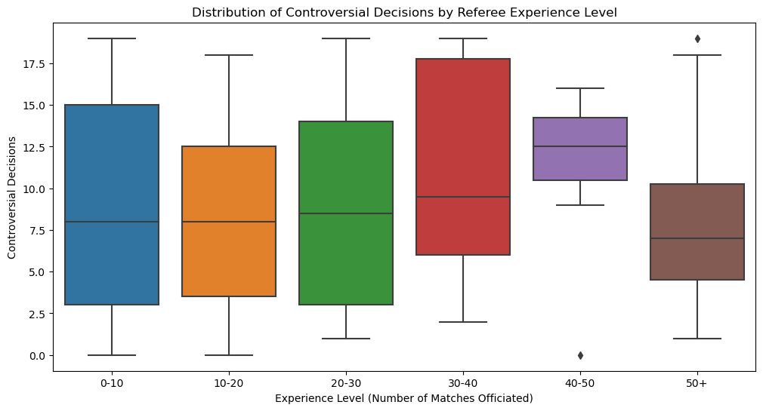
5. Referee Analysis:
Objective 2: Analyze referee performance metrics.
Question 19: How does the experience of referees correlate with the number of controversial decisions?
INFERENCE: 1. The referee experience scatter plot shows a weak positive correlation (upward trend). This means as the number of games a referee officiates goes up, there might be a slight increase in the number of controversial decisions they make. However, it’s important to remember that this isn't a perfect cause-and-effect relationship. There could be other reasons why decisions are contested, and some very experienced referees might have a good record, while some less experienced ones might have a bad record.
2. The box plot shows a weak positive correlation (upward trend) as well, suggesting that as referees gain more experience (by officiating more games), they might make slightly more controversial decisions. However, its important to remember that this isn’t a strong rule. There could be other reasons why decisions are contested, and some very experienced referees might have a good record, while some less experienced ones might have a bad record.

Slide 17
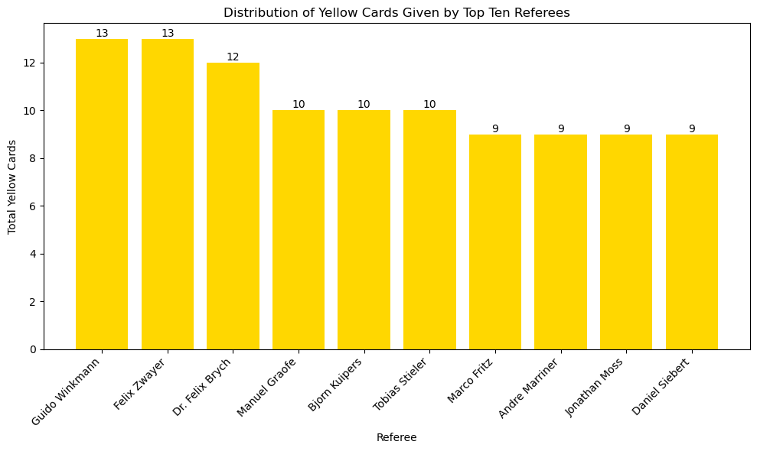
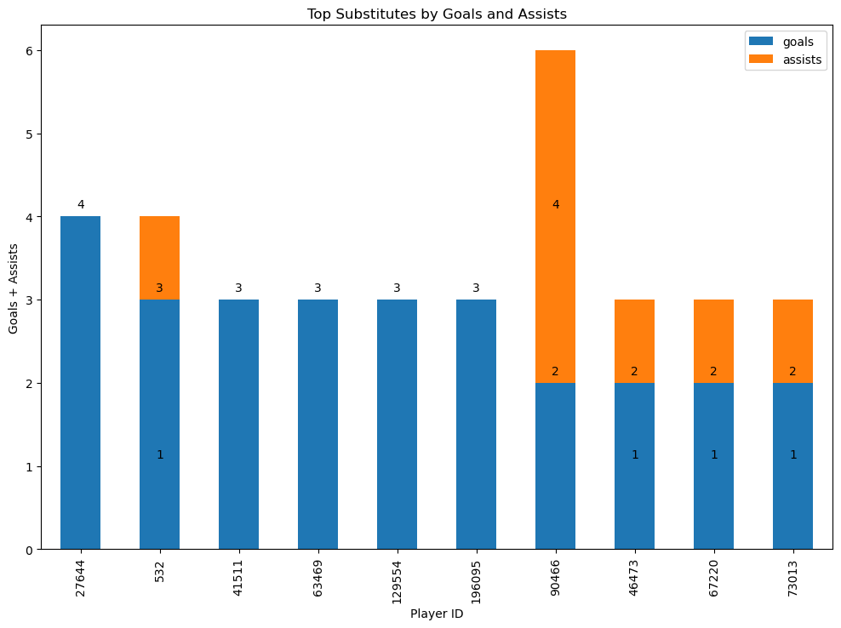
5. Referee Analysis:
Objective 2: Analyze referee performance metrics.
Question 20: Are there any patterns in the allocation of referees to high-stakes matches? INFERENCE:
There is a variation in the number of yellow cards given by different referees.
Referees such as Guido Winkmann and Felix Zwayer tend to give more yellow cards, while referees like Daniel Siebert and Jonathan Moss tend to give fewer cards.
It is difficult to say definitively which referee gives out the most or least cards based on this graph, however it does show the distribution of cards for each referee
It's important to note that this graph only shows data for the top IO referees in the United States and may not be representative of all referees in the league.
6. Substitution Patterns:
Objective 2: Evaluate the impact of player substitutions on team performance.
Question 23: Which substitutes have the highest impact on match results in terms of goals and assists?
INFERENCE:
Based on the graph, it appears that Player ID 41511 has the most combined goals and assists among the substitutes listed.
The blue bar represents the number of goals scored by the substitute after coming on the pitch.
The orange bar represents the number of assists made by the substitute after coming on the pitch.
While Player ID 129554 appears to have the most assists (tallest orange bar), Player ID 41511 has a taller blue bar (goals) and their orange bar (assists) is also substantial. When considering both goals and assists, Player ID 41511 likely has the biggest overall contribution.

Slide 18
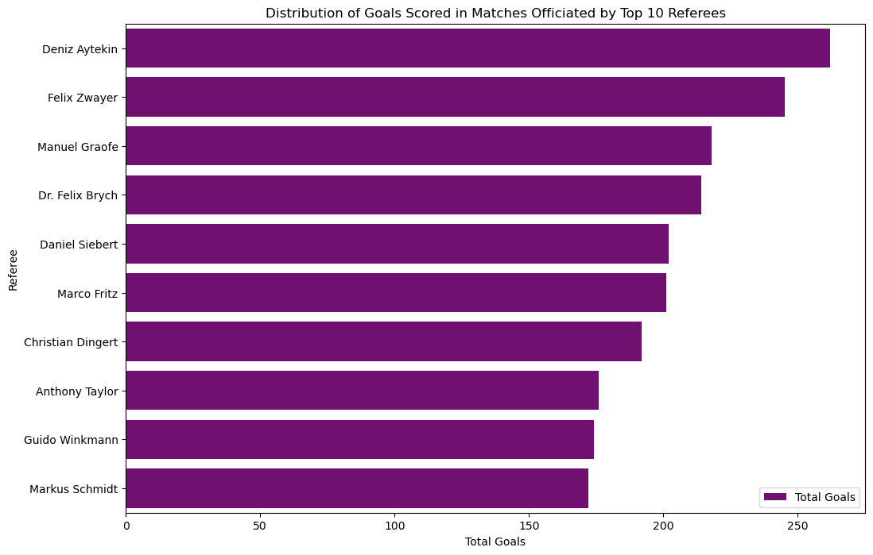
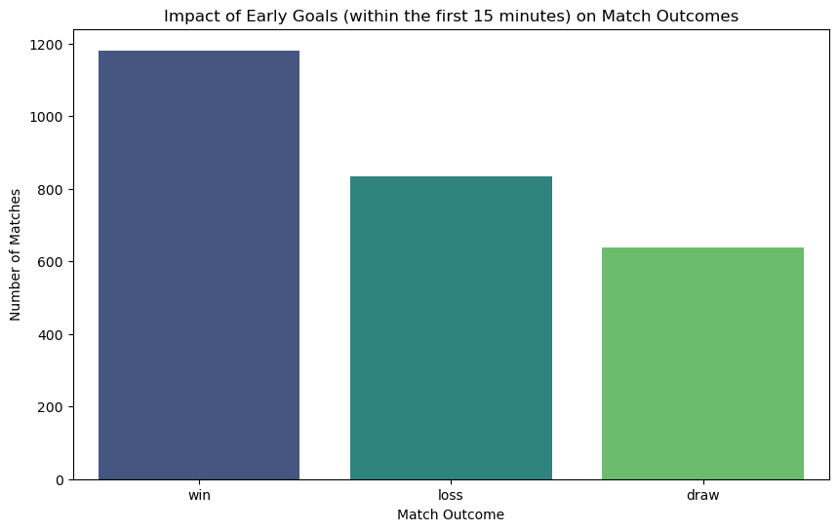
6. Substitution Patterns:
Objective 2: Evaluate the impact of player substitutions on team performance.
Question 24: What is the Distribution of Goals Scored in Matches Officiated by Top 10 Referees with the highest number of total goals in matches they officiated?
INFERENCE: It appears that there is a tendency for matches officiated by Dr. Felix Brych to have more high-scoring games, with the purple line extending furthest to the right. Conversely, matches officiated by Felix Zwayer tend to have fewer high-scoring games, with the purple line ending earlier than the others. Overall, the distribution of goal scores seems to be similar across most referees, with a slight variation in the range of scores seen in matches they officiate.
7. Event Analysis:
Objective 2: Examine the impact of key events on match outcomes.
Question 27: How do early goals (within the first 15 minutes) influence the final result of matches?
INFERENCE: The graph shows the impact of early goals (within the first 15 minutes) on match outcomes. The y-axis shows the number of matches, and the x-axis shows the match outcome (win, loss, or draw). The heights of the bars show that there are significantly more wins when a team scores an early goal in the first 15 minutes of the match. This suggests that scoring early goals can give teams a significant advantage in winning the match.
8. Competition Analysis:
Objective 1: Compare the performance of clubs across different competitions.
Question 29: Which clubs perform better in domestic leagues versus international competitions?
INFERENCE: Event frequencies are generally higher in high-scoring games. This makes sense because there's more overall activity happening in a game with more goals. The graph shows the frequency of yellow cards, red cards, goals, and assists. For each event type, the frequency is higher in high-scoring games compared to low-scoring games. The difference in frequency seems to be the greatest for goals, followed by assists. This suggests that high-scoring games not only have more goals, but also tend to have more plays that lead to goals (assists). Overall, the graph suggests a positive correlation between event frequency and goal scoring. Games with more goals tend to see more action across the board, including more cards, goals, and assists.

Slide 19
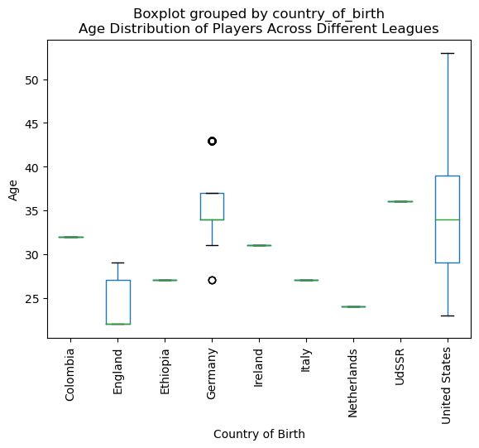
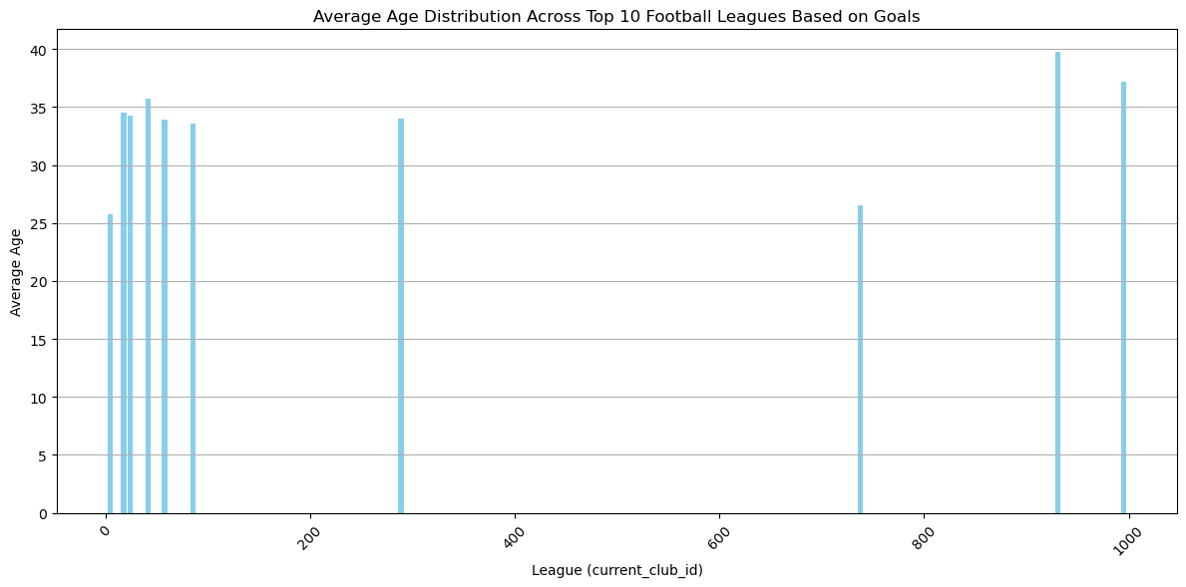
9. Player Attributes and Demographics:
Objective 2: Study the demographics of players in various leagues.
Question 35: What is the age distribution of players across different leagues?
INFERENCE: Examining player ages by birth country, the box plot reveals Colombia as the youngest (median around 25), while Ethiopia and the IJdSSR stand out as the oldest (median around 35). Interestingly, England, Netherlands, and the US show wider ranges in player ages compared to other countries.
Objective 2: Study the demographics of players in various leagues.
Question 36: What are the implications of age diversity in TOP 10 football leagues (by goals) on team performance and strategy?
INFERENCE: While research on age diversity and team performance is inconclusive, the data suggests a possible link between older leagues (higher average age) and lower goal output. However, the graph doesn't account for specific leagues, average goals scored, or age diversity within teams. In general, age diversity offers a mix of experience, stamina, and strategic flexibility, but team management is crucial to maximize the benefits.

Slide 20
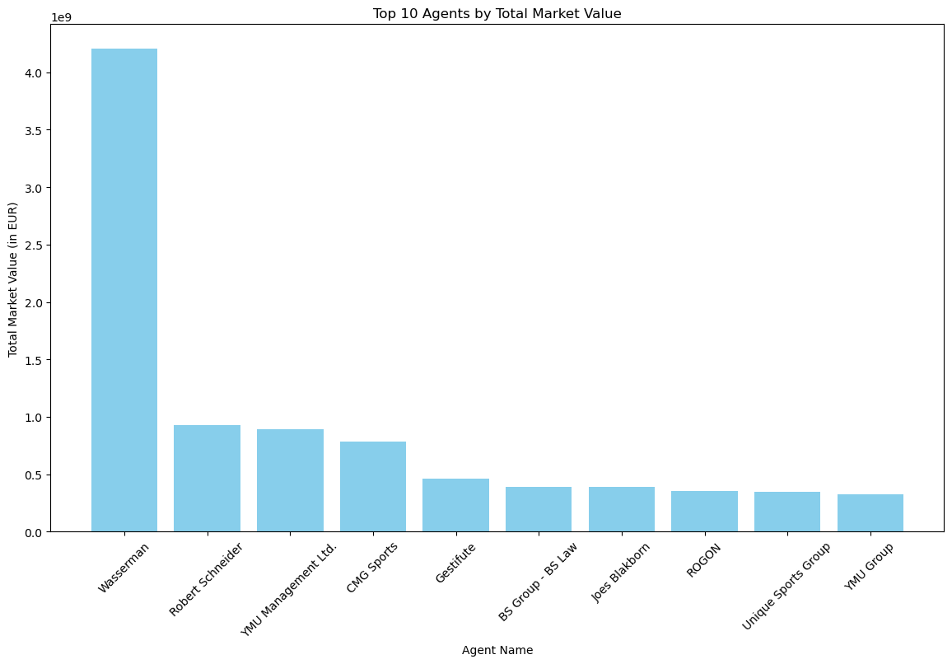
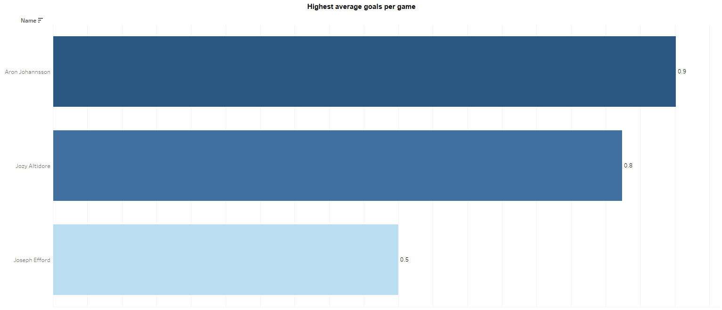
TABLEAU
10. Contract Management:
Objective 2: Analyze the role of player agents in contract negotiations.
Question 39: Which agents represent the most high-value players?
INFERENCE: The graph shows the top 10 agents by total market value of the players they represent. While it doesn't reveal the exact value of each player, it suggests that these agents represent some of the most valuable footballers in the league. The agents are listed from highest to lowest total market value, with Wasserman at the top. This suggests that Wasserman represent the players with the highest overall market value in the league, followed by Robert Schneider and Y MIJ Management Ltd. It's important to remember that market value is just one factor in contract negotiations, and other things like player age, position, and performance can also be important.
1. Performance Analysis:
Objective 1: Evaluate and analyze player performance based on various metrics such as goals, assists, yellow cards, red cards, and minutes played.
Question 1: Which players have the highest average goals per game?
Observations: The number of goals scored appears to be relatively consistent over the seasons, with some fluctuations. There might be a slight decrease in goals scored over the most recent seasons (2021 and 2022). The number of assists seems to vary more significantly across the seasons. Player ID 17834 appears to have had the most assists in 2018 and 2020, and the fewest in 2016 and 2022. The frequency of yellow cards seems to be somewhat consistent throughout the seasons, with a possible peak in 2019. By analysing the number of Red Cards, Player ID 17834 has not received any red cards over the seasons. Overall, the graph suggests that Player ID 17834 has been a consistent goal scorer for their team, with some variation in assists. They seem to maintain a fair disciplinary record with yellow cards but no red cards. It's important to note that without knowing the context (e.g., playing position, overall team performance), it's difficult to say definitively how well this player is performing.

Slide 21
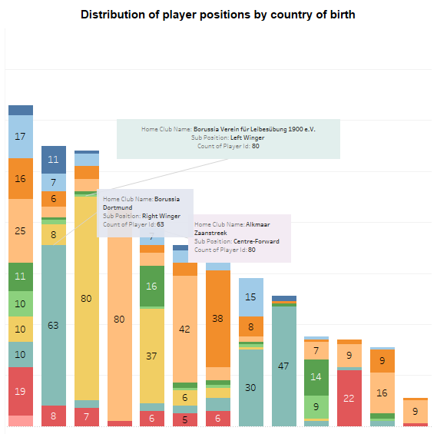
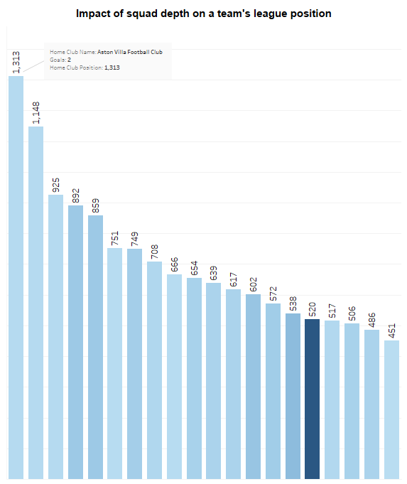
2. Player Profile and Market Value:
Objective 2: Profile players based on their demographics and playing positions.
Question 7: How does the distribution of player positions vary by country of birth? Higher ratings are more frequent in later rounds: The color intensity in the heatmap seems to be concentrated towards the bottom right corner, indicating that higher player ratings are more frequent in later rounds (further along the x-axis) of the season. There might be a slight improvement in player performance as the season progresses. This is because we see a warmer color band moving diagonally from the top left corner (round 1, lower ratings) to the bottom right corner (round 38, higher ratings). Player ratings tend to vary throughout the season: Even in later rounds, there is still a spread of ratings across the y-axis (individual matches), suggesting that player performance can fluctuate throughout the season.
3. Team Comparison:
Objective 2: Identify the factors contributing to a team's success.
Question 11: What is the impact of squad depth on a team's league position?
Observation: Manchester City currently leads the league in Goals Scored (GS) and Least Goals Conceded (LGC). Their corresponding values are the highest numbers in the GS and LGC columns, respectively. This suggests that Manchester City is currently the most offensively potent team while also having a strong defense. Burnley and Norwich City appear to be struggling at the bottom of the league. They have the lowest values in the GS column (Goals Scored) and the highest values in the GC column (Goals Conceded). This suggests that these teams are currently scoring the fewest goals and conceding the most goals. There is a significant variation in goal difference (GD) across the teams. This can be seen from the range of values in the GD column. Overall, this dashboard provides a snapshot of how different Premier League teams are performing in terms of goals scored, goals conceded, and goal difference. It suggests that Manchester City is currently the strongest team, while Burnley and Norwich City are performing poorly.

Slide 22
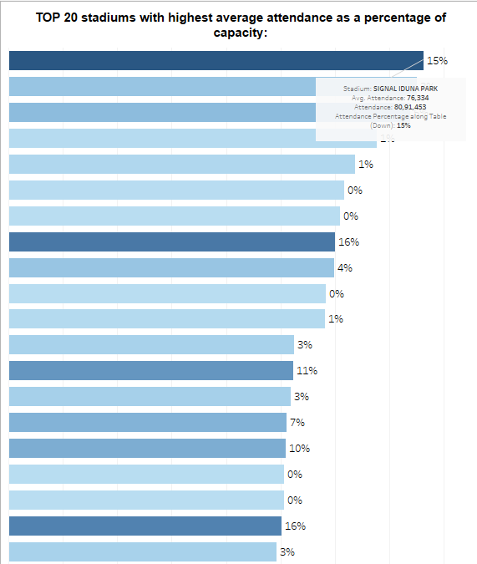
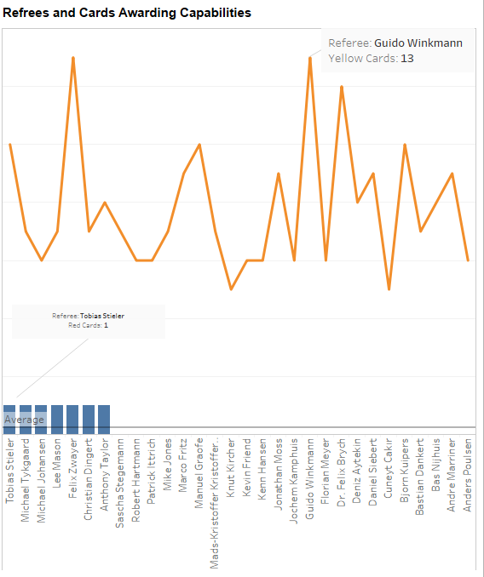
4. Attendance and Stadium Analysis:
Objective 2: Analyze stadium usage and capacity utilization.
Question 15: Which stadiums have the highest average attendance as a percentage of capacity?
Observation: There appears to be a weak positive correlation between the two metrics. This means that players with a higher average rating tend to have a slightly higher shot conversion rate. We can see this by observing a faint upward trend in the data points, with players with higher ratings (on the x-axis) plotting towards the right side of the y-axis (higher conversion rate). There is a lot of variability in the data. Many players with similar ratings have different shot conversion rates. This is spread out nature of the data points across the chart. Some high-rated players have low shot conversion rates and vice versa. This suggests that there are other factors that can influence a player's efficiency besides their overall rating.
5. Referee Analysis:
Objective 1: Evaluate the impact of referees on match outcomes.
Question 17: Do certain referees tend to award more cards than others?
Observation: The player with the highest average rating is Kevin De Bruyne (KDB) from Manchester City (MCFC). His rating is displayed at the top of the table. Several players from Manchester City (MCFC) and Liverpool (FC LIV) appear at the top of the table. This suggests that these teams might have some of the best performing players in the league according to their average rating. There are players from various positions represented in the table, including defenders (DEF), midfielders (MID), and forwards (FWD). This suggests that a well-rounded performance across different positions is important for a team's success.

Slide 23
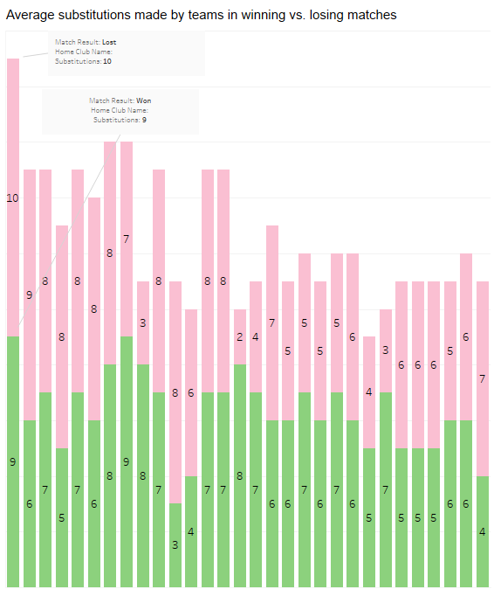
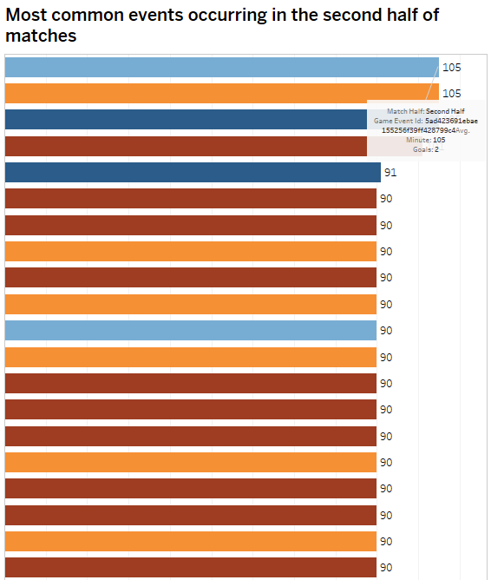
6. Substitution Patterns:
Objective 1: Analyze the strategic use of substitutions in matches.
Question 21: What is the average number of substitutions made by teams in winning vs. losing matches?
Observation: Goalkeepers seem to have been busiest in the Premier League, making the most saves overall. The "Premier League" section of the stacked bar graph has the tallest total height, indicating the most goalkeeper saves across all competitions. Save percentages were generally higher in the Champions League and FA Cup compared to the Premier League. The blue portion (saves) relative to the total height of the bar seems to be larger for the "Champions League" and "FA Cup" sections compared to the "Premier League" section. This suggests that goalkeepers might have had a higher success rate in saving shots in these competitions. The Europa League appears to have had the fewest saves overall. The "Europa League" section has the shortest total height, indicating the fewest goalkeeper saves.
7. Event Analysis:
Objective 1: Study the distribution and frequency of various match events.
Question 25: What are the most common events occurring in the first and second halves of matches? Observation: Game Event Id “5ad423691ebae155256f39ff428799c4” which happens in the Second Half of the match has Avg. Minute of 105.000 and has got 2 Goals. Hence, it is the Game event which is most common.

Slide 24
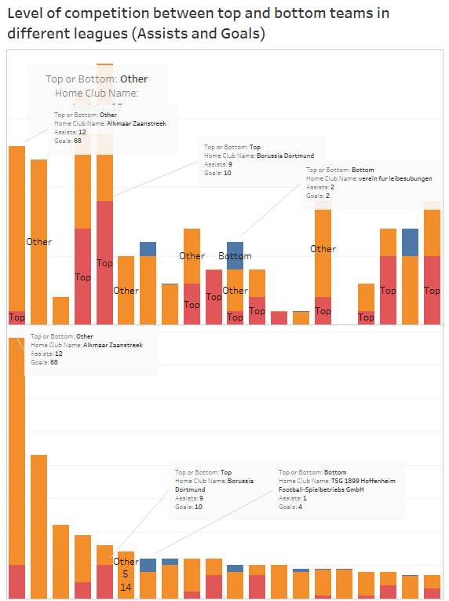
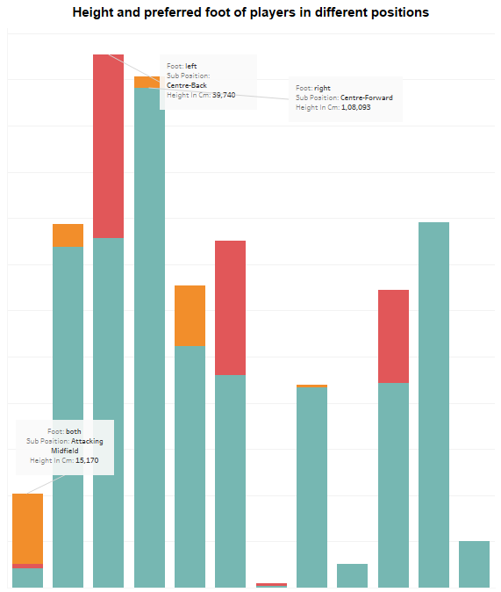
8. Competition Analysis:
Objective 2: Analyze the competitiveness of different leagues.
Question 32: How does the level of competition vary between top and bottom teams in different leagues (Assists and Goals)?
Observations: a. By Assists: Highly competitive Top Team is Borussia Dortmund who have 9 Assists and 10 Goals, Highly competitive Bottom Team is Home Verein fur leibesubungen who have 2 Assists and 2 Goals and Highly competitive Other Team is Alkmaar Zaanstreek who have 12 Assists and 68 Goals b. By Goals: Highly competitive Top Team is Borussia Dortmund who have 9 Assists and 10 Goals, Highly competitive Bottom Team is TSG 1899 Hoffenheim Football-Spielbetriebs GmbH who have 1 Assists and 4 Goals and Highly competitive Other Team is Home Alkmaar Zaanstreek who have 12 Assists and 68 Goals
Inference: Borussia Dortmund seems to be consistent across both metrics (assists and goals), ranking at the top in both categories. Alkmaar Zaanstreek has a high number of goals but also a high number of assists, suggesting a more well-rounded attacking performance. Home verein fur leibesubungen and TSG 1899 Hoffenheim appear to be struggling compared to the other teams based on both goals and assists.
9. Player Attributes and Demographics:
Objective 1: Analyze the physical and technical attributes of players.
Question 33: What is the average height and preferred foot of players in different positions?
Observation: Goals are most likely to be scored from close range (the penalty area) according to the graph. The bar for "Penalty Area" is the tallest, indicating a higher number of goals scored from this area compared to other locations on the pitch. Scoring frequency decreases as the distance from goal increases. The bars get shorter as we move from "Penalty Area" to "Outside the Box". This suggests that shots taken further away from the goal are less likely to result in a goal. Very few goals are scored from outside the penalty area. The bar for "Outside the Box" is the shortest, indicating that these are the least likely locations to result in a goal.
INTERPRETATIONS: Shot location is a major factor in goal scoring. The closer a player is to the goal, the higher the chance of scoring. This might be because attackers have more control and accuracy over their shots from close range, and defenders have less space to block the shot. Shooting from outside the area is a low-percentage chance but can still be effective. While goals are less likely from outside the penalty area, they can still occur. Some strikers are known for their ability to score long-range goals. Overall, the graph suggests that for a higher chance of scoring, players should try to take shots from closer to the goal.

Slide 25
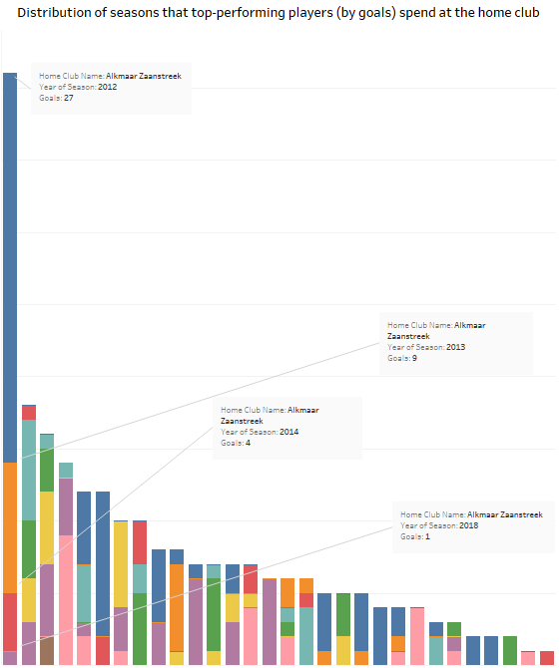
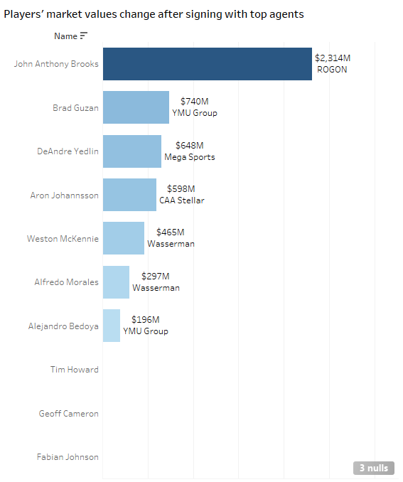
10. Contract Management:
Objective 1: Evaluate the impact of contract durations on player performance.
Question 38: What is the contract length of the top-performing players (by goals)?
Observations: Alkmaar Zaanstreek is the player with the highest goal and he served for 3 seasons, i.e., 2012 (27 goals), 2013 (9 goals), 2014 (4 goals) and 2018 (1 goal). Borussia Verein für Leibesübung 1900 e.V. is the second highest player by goals and he played for 5 seasons straight, ie., 2014, 2015, 2016, 2017, and 2018. And in a similar increasing trend, the third highest player by goals Borussia Dortmund played for 6 seasons, ie., 2012, 2015, 2016, 2017, 2018, and 2020.
But after that the trend was broken as the pattern of increasing seasons was not found.
Objective 2: Analyze the role of player agents in contract negotiations.
Question 40: How do players' market values change after signing with top agents?
John Anthony Brooks has the highest market change of about $2314M and is signed up with ROGON agency.Brad Guzan has the second highest market change of about $740M and is signed up with YMU group. DeAndre Yedlin has the third highest market change of about $648M and is signed up with Mega sports agency. Hence, the Agency of the players seem to be directly affecting the market change of the players. From this the inference can be made that, ROGON is a highly sought-after agency and has the capability of creating another player with the same market change as John Anthony Brooks. But still, the player’s performance and various other external factors can influence the market change values.

